Slide 1
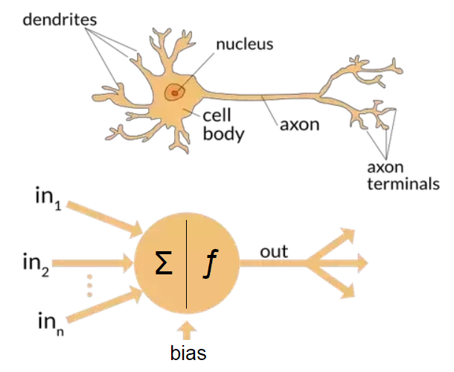
Structure of a neural network

Slide 2
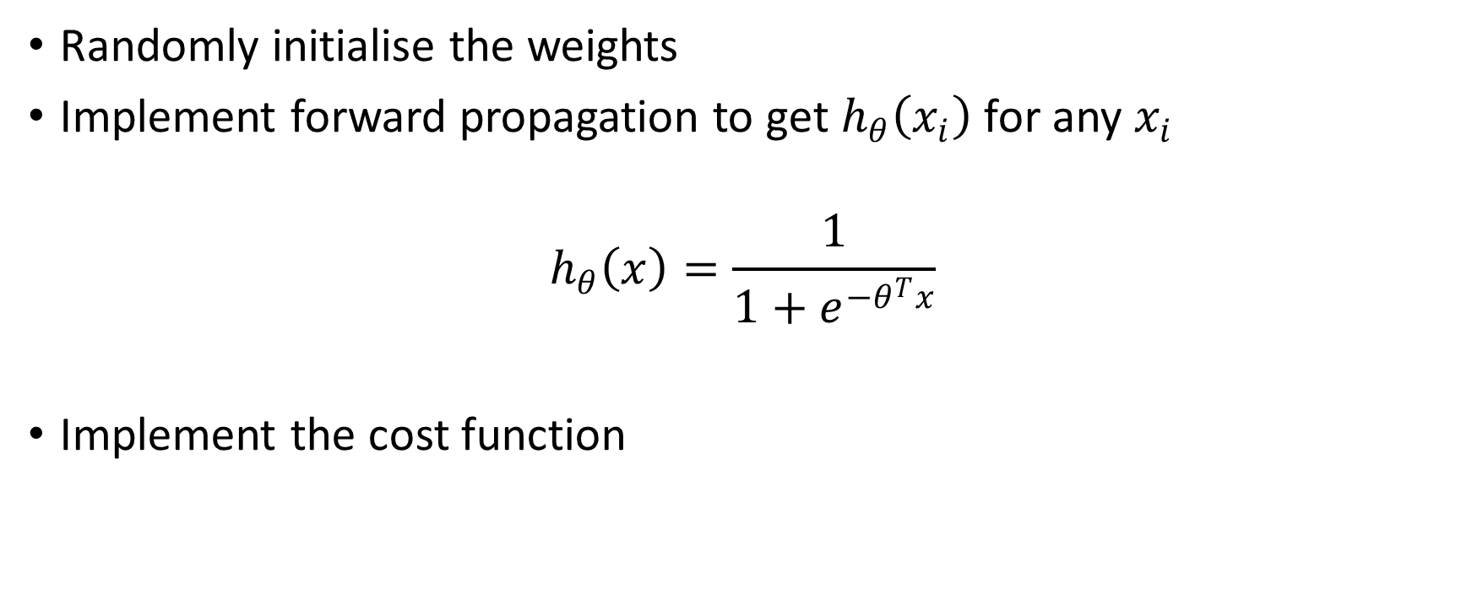
Algorithm
Randomly initialise the weights
Implement forward propagation to get $h_{θ}\left(x_{i}\right)$ for any $x_{i}$
$$h_{θ}\left(x\right)=\frac{1}{1+e^{−θ^{T}x}}$$
Implement the cost function

Slide 3
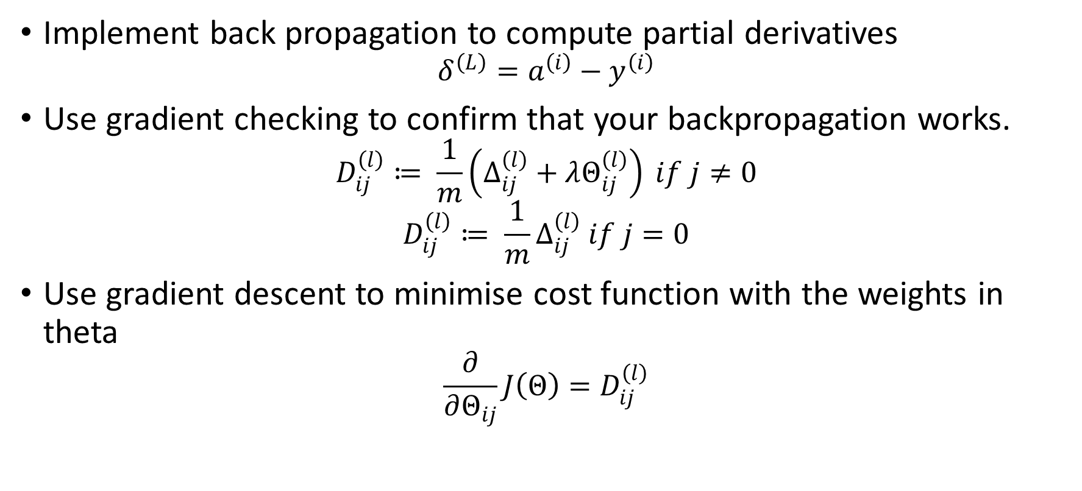
Algorithm
Implement back propagation to compute partial derivatives
$$δ^{\left(L\right)}=a^{\left(i\right)}−y^{\left(i\right)}$$
Use gradient checking to confirm that your backpropagation works.
$$D_{ij}^{\left(l\right)}≔ \frac{1}{m}\left(∆_{ij}^{\left(l\right)}+λΘ_{ij}^{\left(l\right)}\right) if j≠0$$
$$D_{ij}^{\left(l\right)}≔ \frac{1}{m}∆_{ij}^{\left(l\right)} if j=0$$
Use gradient descent to minimise cost function with the weights in theta
$$\frac{∂}{∂Θ_{ij}}J\left(Θ\right)=D_{ij}^{\left(l\right)}$$
Notes:
The deltas multiplied with their respective activations and dividing by the number of samples, with regularisation gives the gradients

